Slide 1

SAT & ACT Analysis in USA
The Project 1 : Standardized Test Analysis
Kanakorn Kuchaiyanont

Slide 2

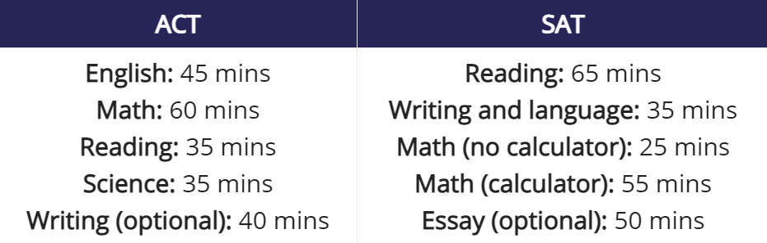
SAT & ACT
The SATs and the ACTs are the two different tests that students are required to take for admittance to a US university.
The difference between SATs and ACTs
Refer : https://www.timeshighereducation.com/student/advice/difference-between-sats-and-acts

Slide 3
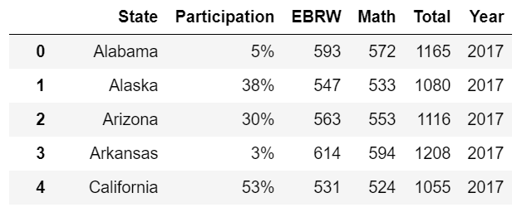
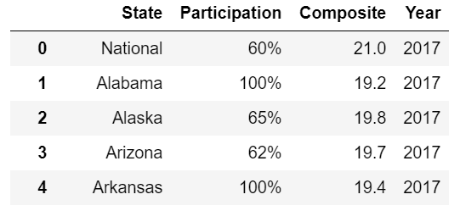
Data Set SAT & ACT (2017-2019)
SAT : USA
ACT : USA
SAT.Columns
Participation : Percentage of participants in each State.
EBRW : Total score of Reading and Writing.
Math : Total score of Mathematics.
Total : EBRW + Math (Between 400 - 1600).
ACT.Columns
Participation : Percentage of participants in each State.
Composite : Total score (Between 1 - 36).

Slide 4
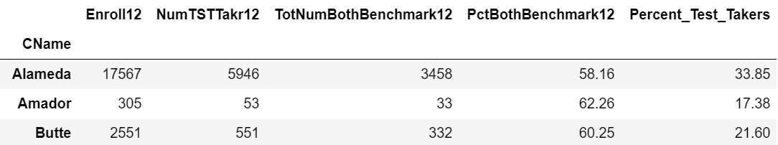
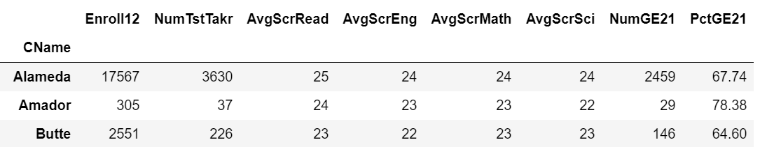
Data Set SAT & ACT (2017-2019)
SAT : California
SAT.Columns
Enroll12 : Enrollment of Grade 12
NumTSTTakr12 : Number of Test Takers Grade 12
TotNumBothBenchmark12 : The total number of students who met the benchmark of both Evidence-Based Reading & Writing (ERW) and Math Grade 12
PctBothBenchmark12 : Percent of TotNumBothBenchmark12
Percent_Test_Takers : Percent of Test Takers/Enrollment
ACT : California
ACT.Columns
Enroll12 : Enrollment of Grade 12
NumTstTakr : Number of Test Takers Grade 12
AvgScrRead : Average ACT Reading Score
AvgScrEng : Average ACT English Score
AvgScrMath : Average ACT Math Score
AvgScrSci : Average ACT Science Score
NumGE21 : Number of Test Takers Whose ACT Composite Scores Are Greater or Equal to 21
PctGE21 : Percent of NumGE21

Slide 5
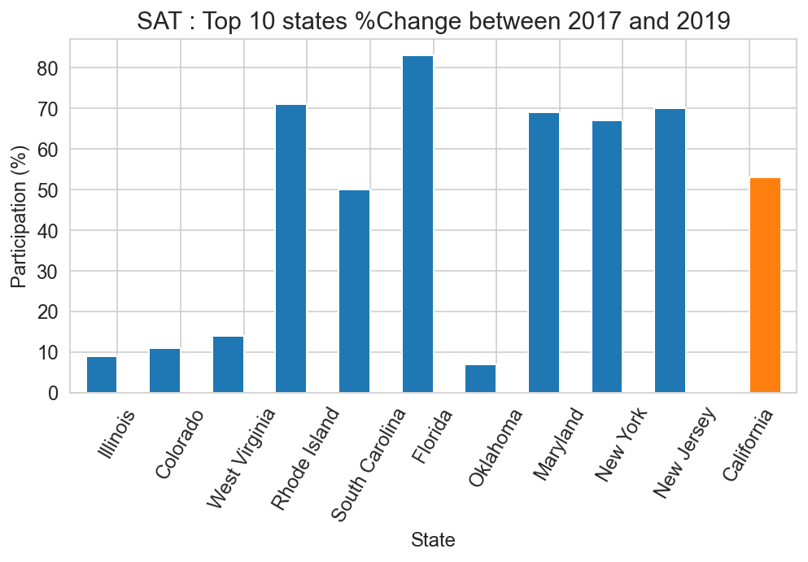
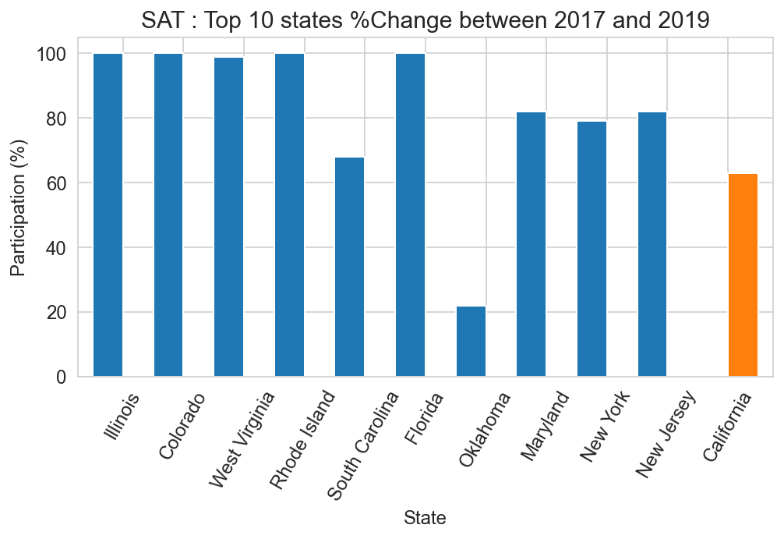
SAT : %Participation (2017-2019)
Top 10 (%Change)
2017
2019

Slide 6
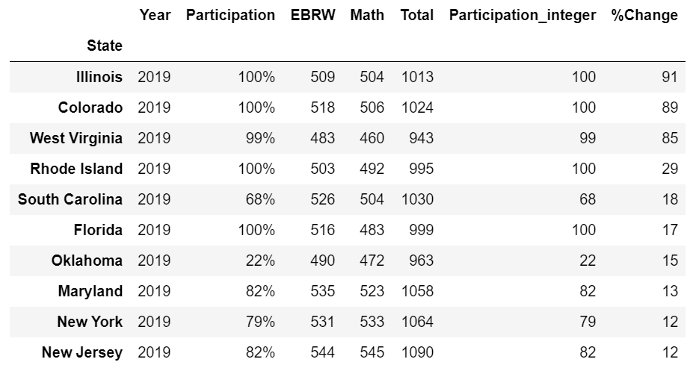
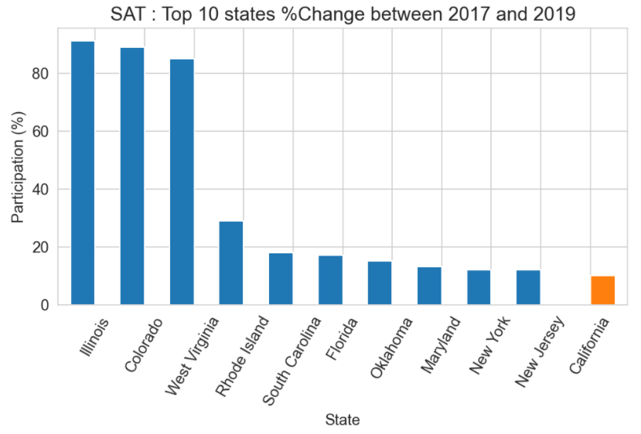
SAT : %Change (2017-2019)
Top 10 (%Change)
%Change = %Participation in 2019 - %Participation in 2017

Slide 7
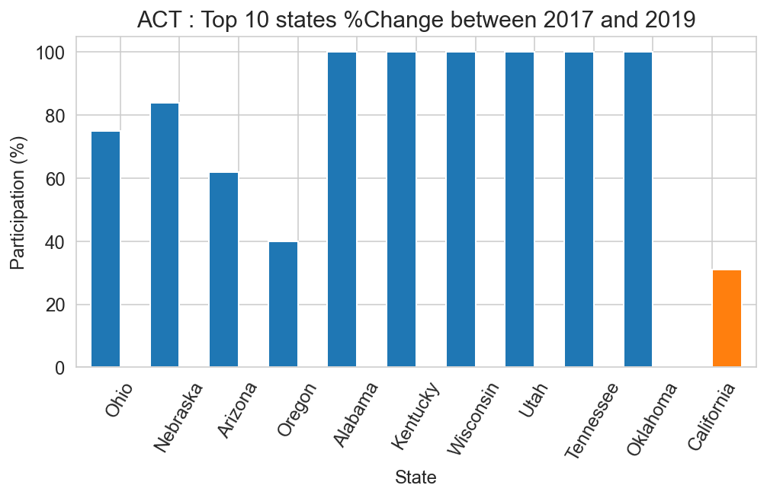
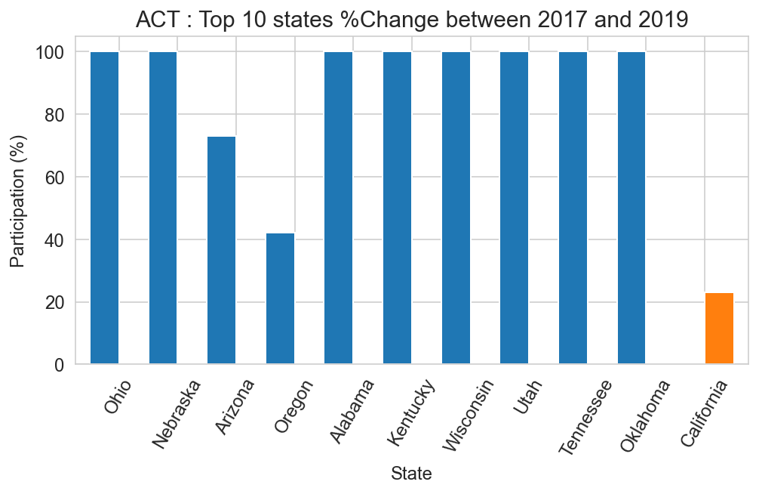
ACT : %Participation (2017-2019)
Top 10 (%Change)
2017
2019

Slide 8
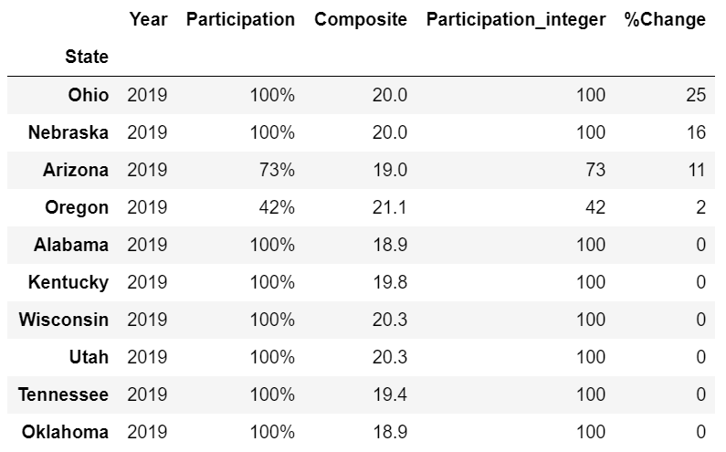
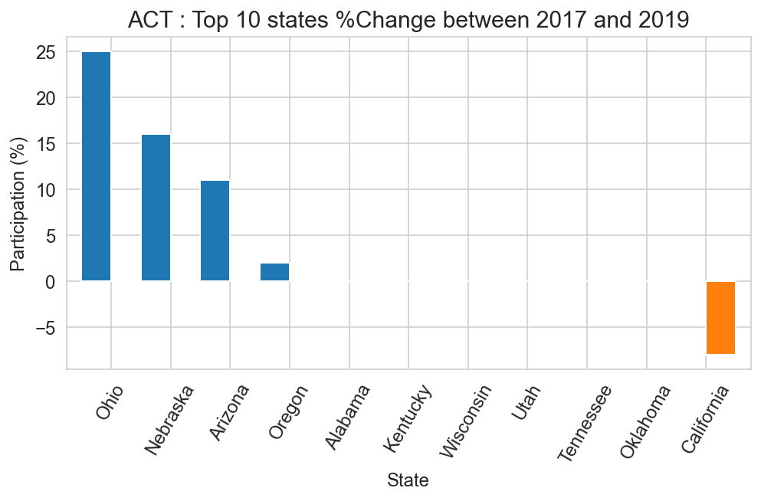
ACT : %Change (2017-2019)
Top 10 (%Change)
%Change = %Participation in 2019 - %Participation in 2017

Slide 9
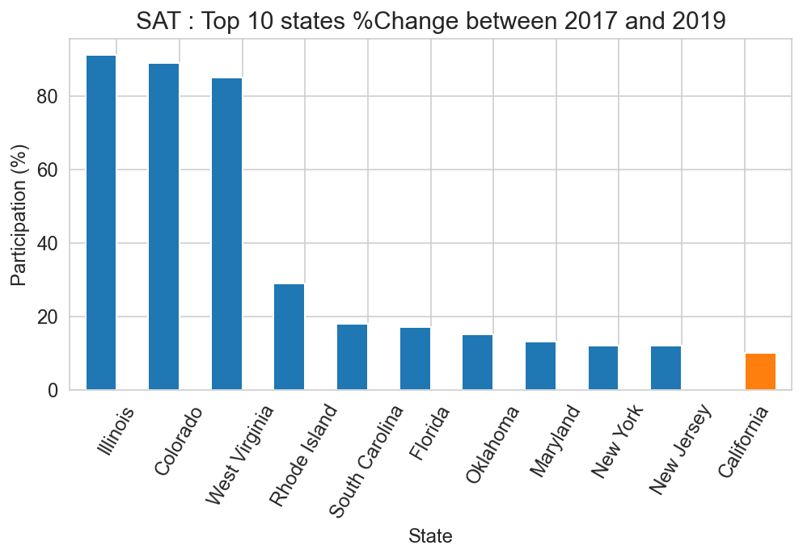
SAT vs ACT (%Change 2017-2019)
SAT
>> Uptrend
ACT
>> Downtrend

Slide 10
California
Orange
San Francisco
Marin
Ventura
Los Angeles
San Bernardino
Riverside
Alameda
San Mateo
Contra Costa

Slide 11
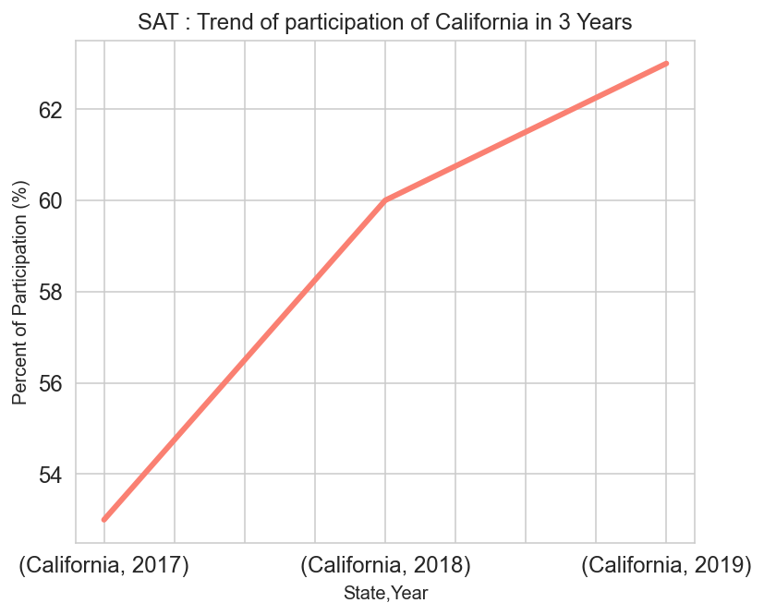
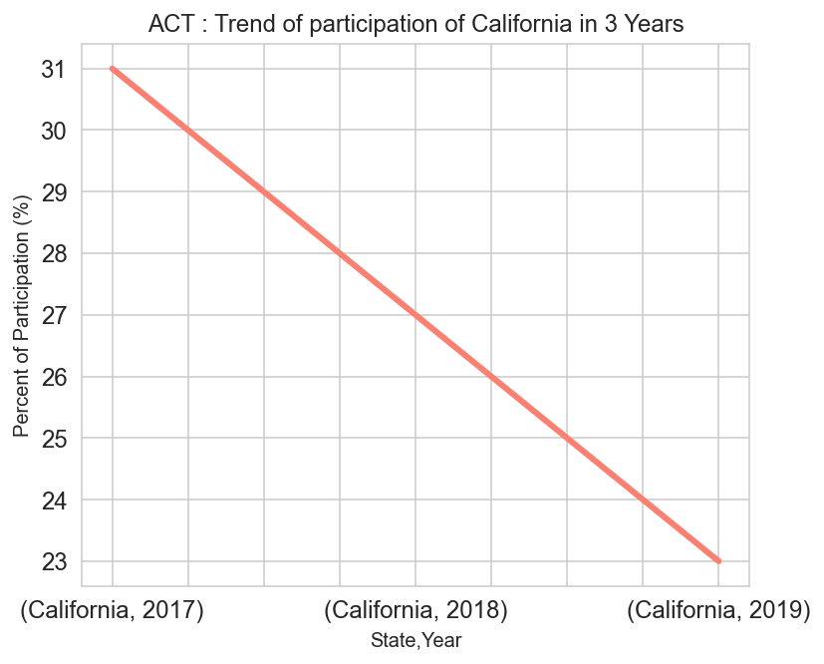
SAT vs ACT in California
SAT
>> Uptrend
ACT
>> Downtrend

Slide 12
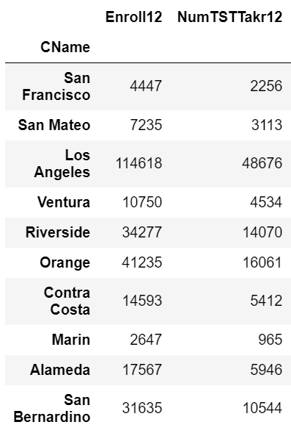
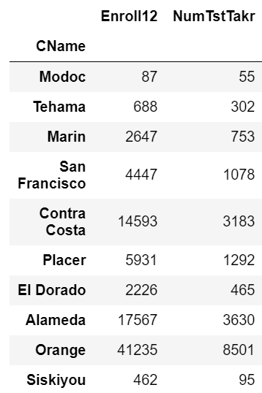
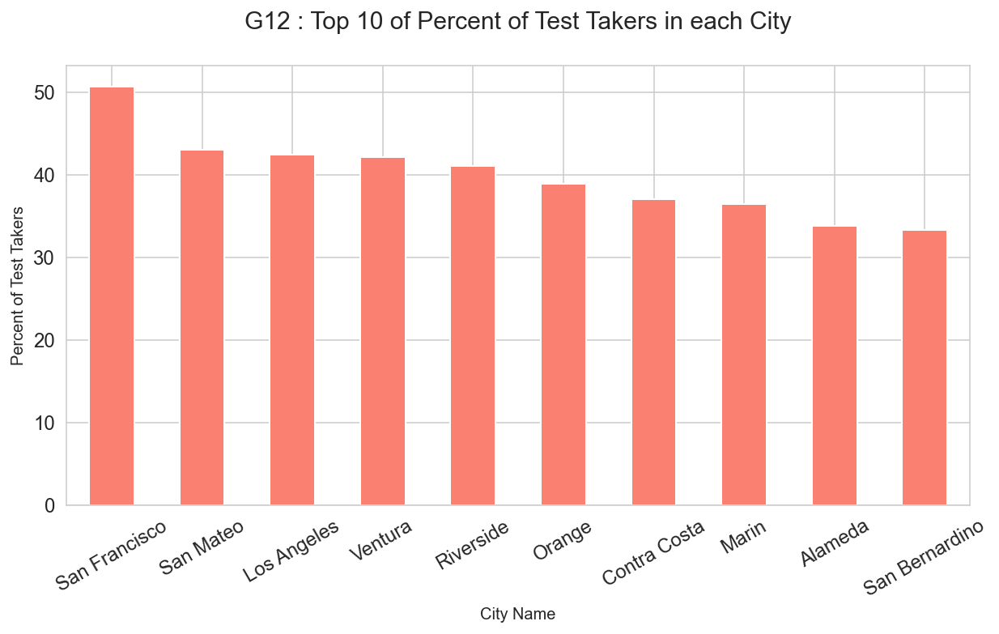
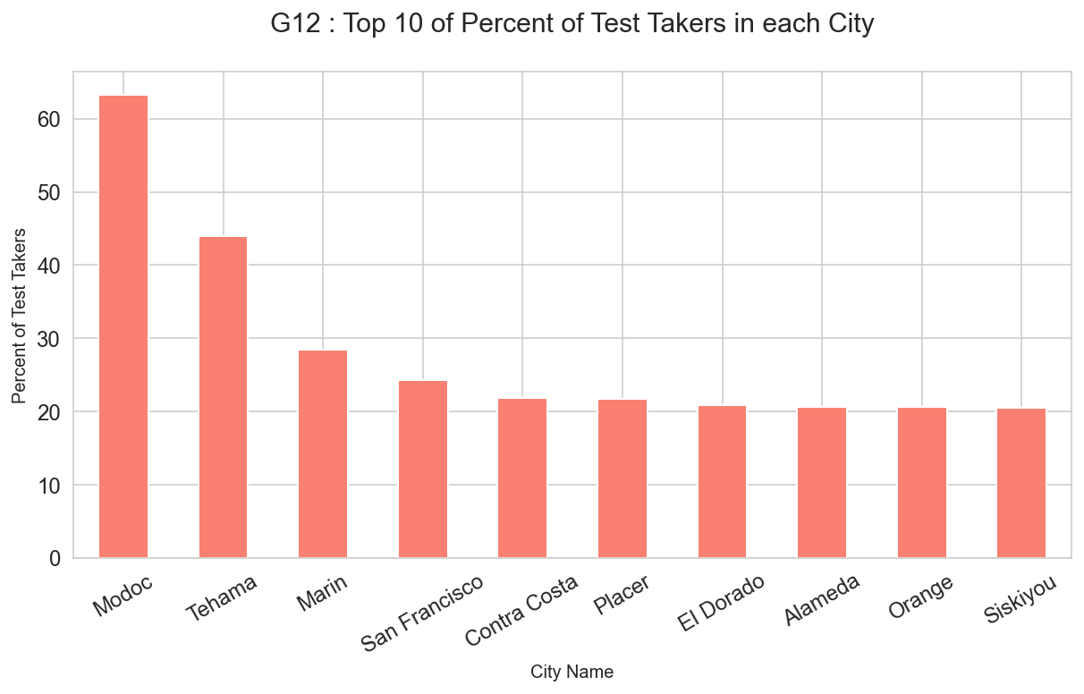
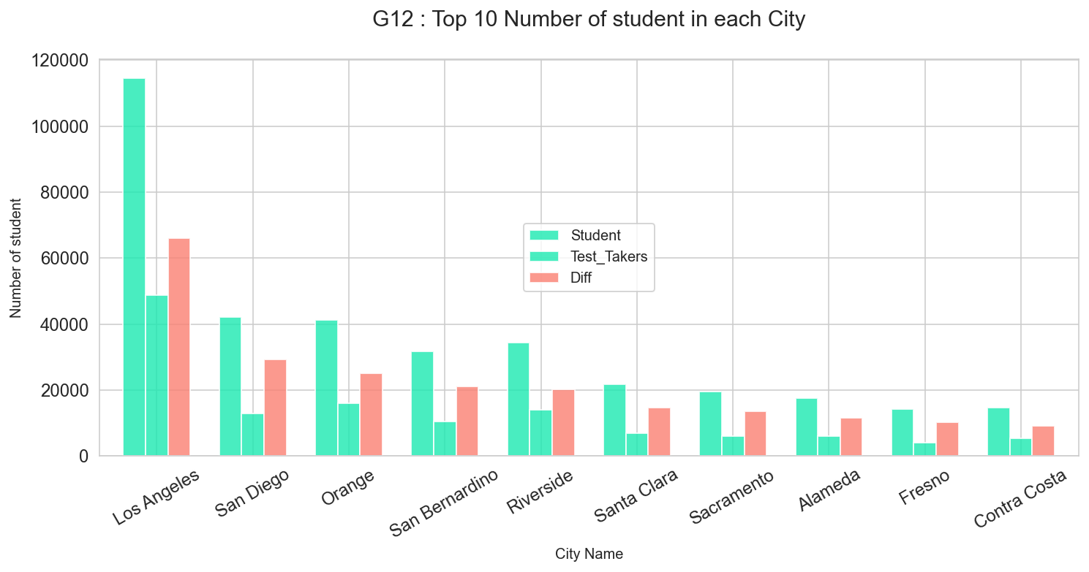
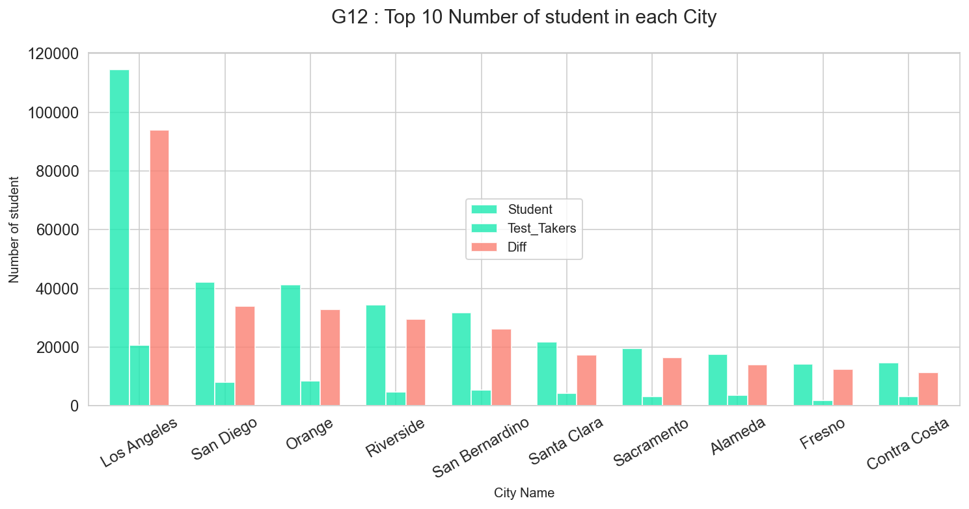
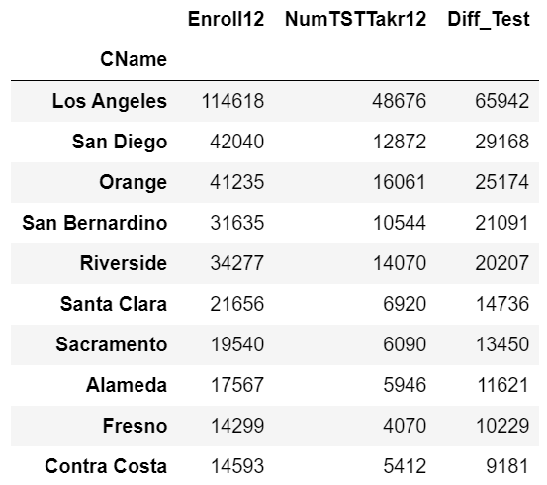
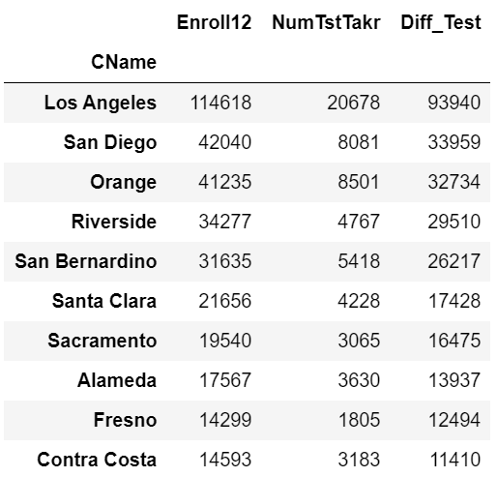
SAT : Top 10
ACT : Top 10

Slide 13
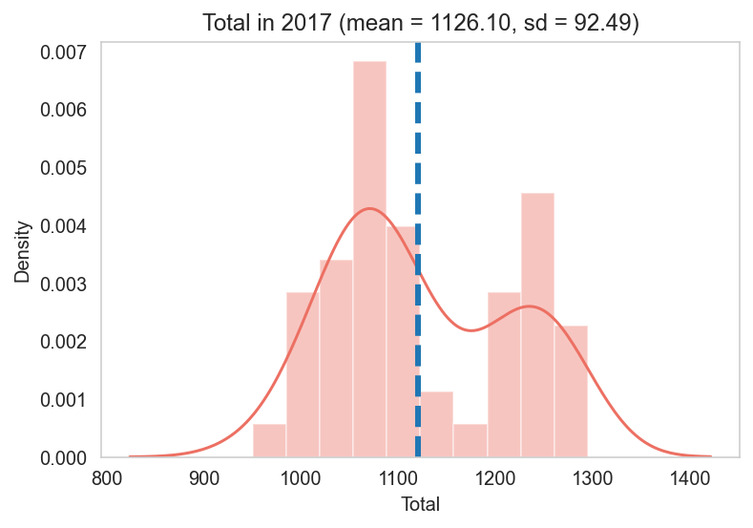
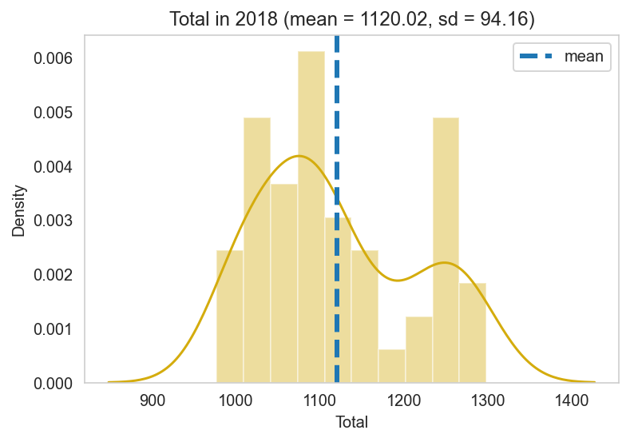
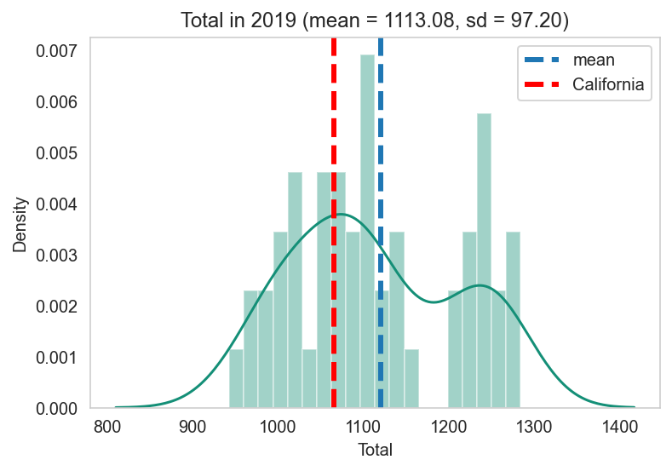
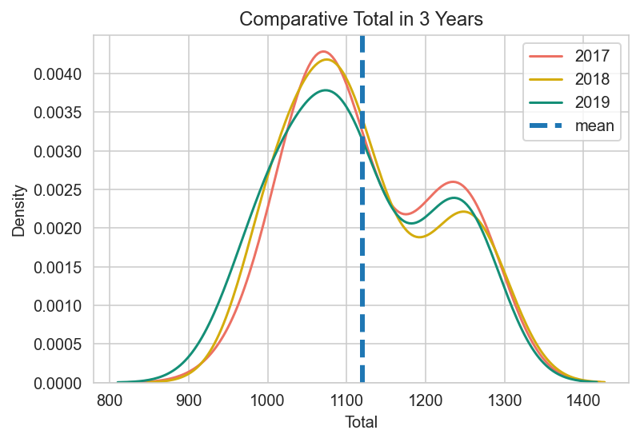
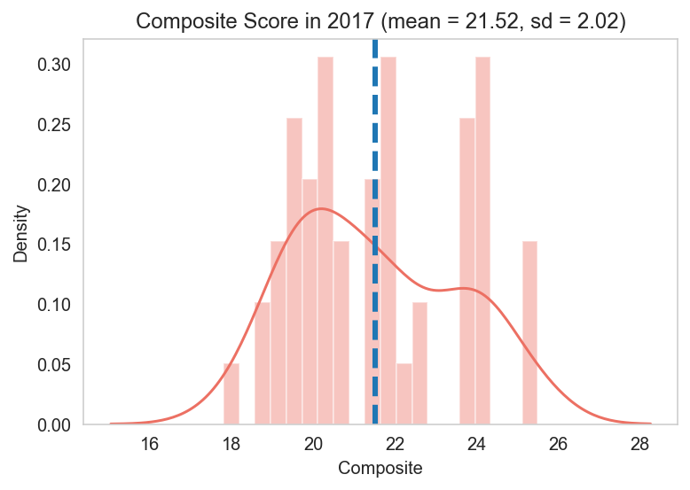
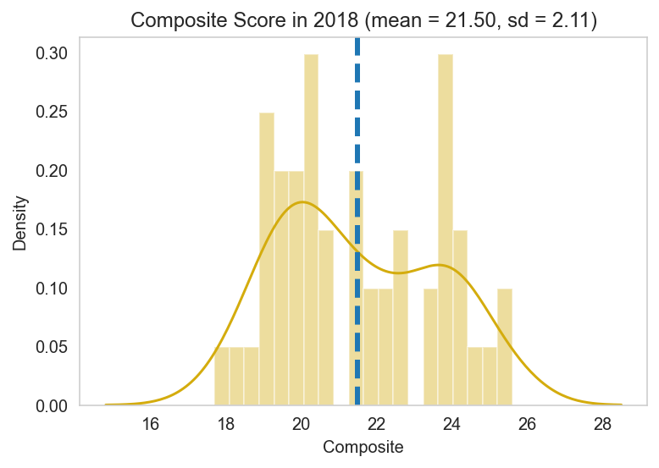
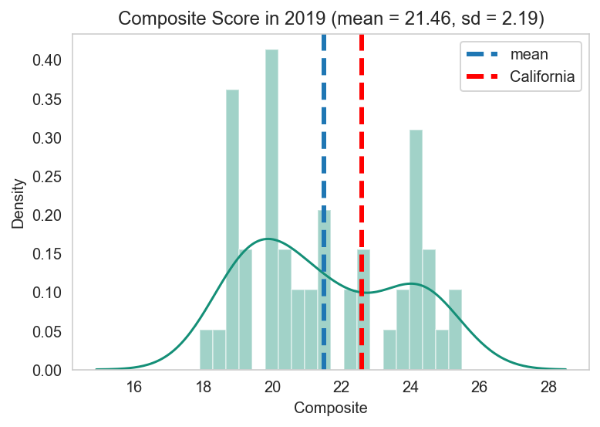
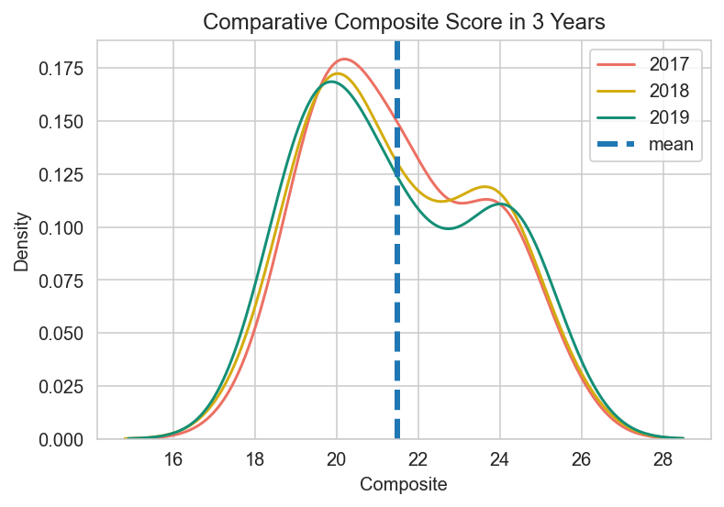
SAT & ACT Total Score Distribution
SAT Score (EBRW + Math)
Mean = 70%
2017
2018
2019
ACT Score
California Score = 1065
Mean = 59.7%
2017
2018
2019
California Score = 22.6

Slide 14
Summary
SAT is still uptrend but ACT is downtrend in USA in the same way with California.
Illinois, Colorado and West Virginia have the most %Change of SAT
Ohio, Nebraska and Arizona have the most %Change of ACT.
Los Angeles has the highest number of student but it has a few of Test takers.
From score of SAT & ACT shown that SAT maybe easier than ACT because it has percent of mean score higher than ACT.
From the above reason, maybe SAT becomes more popular than ACT in USA.

Slide 15
Thanks!
Do you have any questions?
Please keep this slide for attribution

